Slide 1
Solutions Interview Project
Vaidas Razgaitis

Slide 2
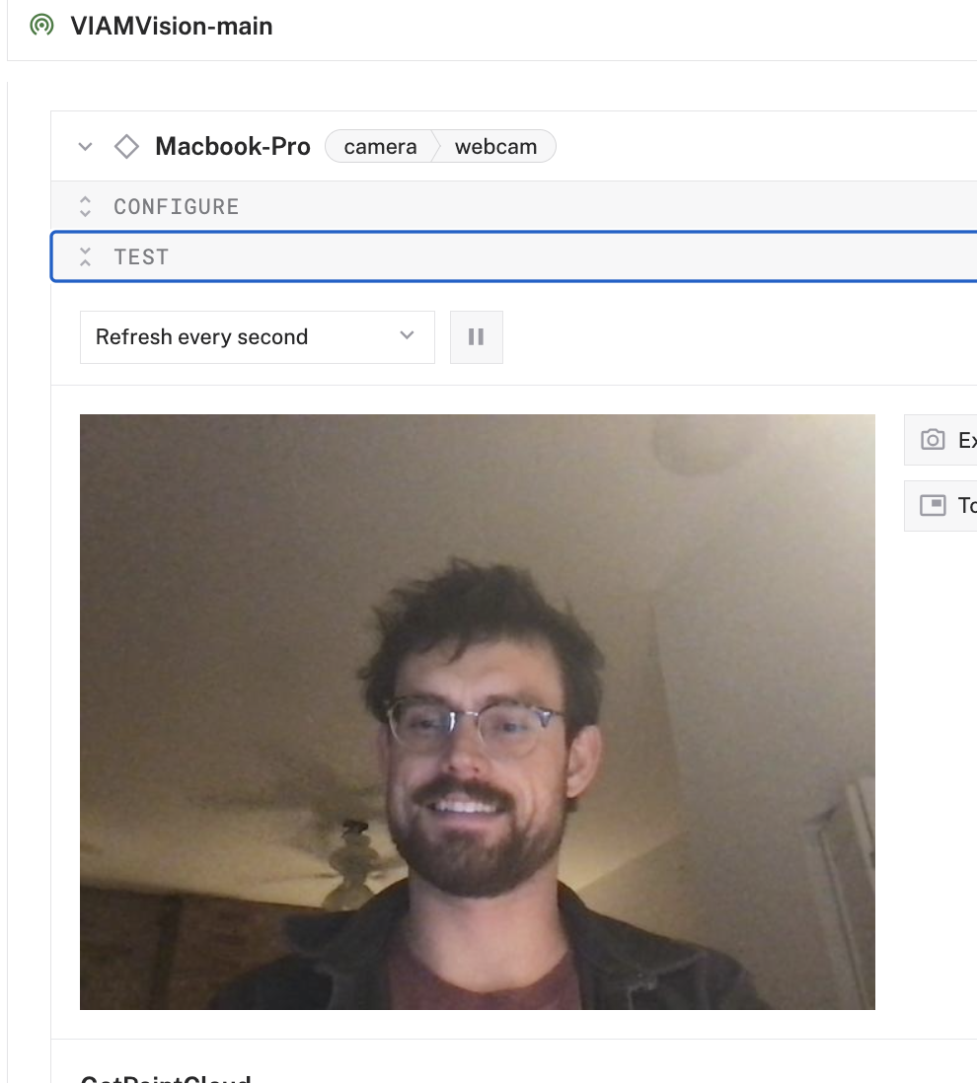
Part 1 – Vision Setup

Slide 3
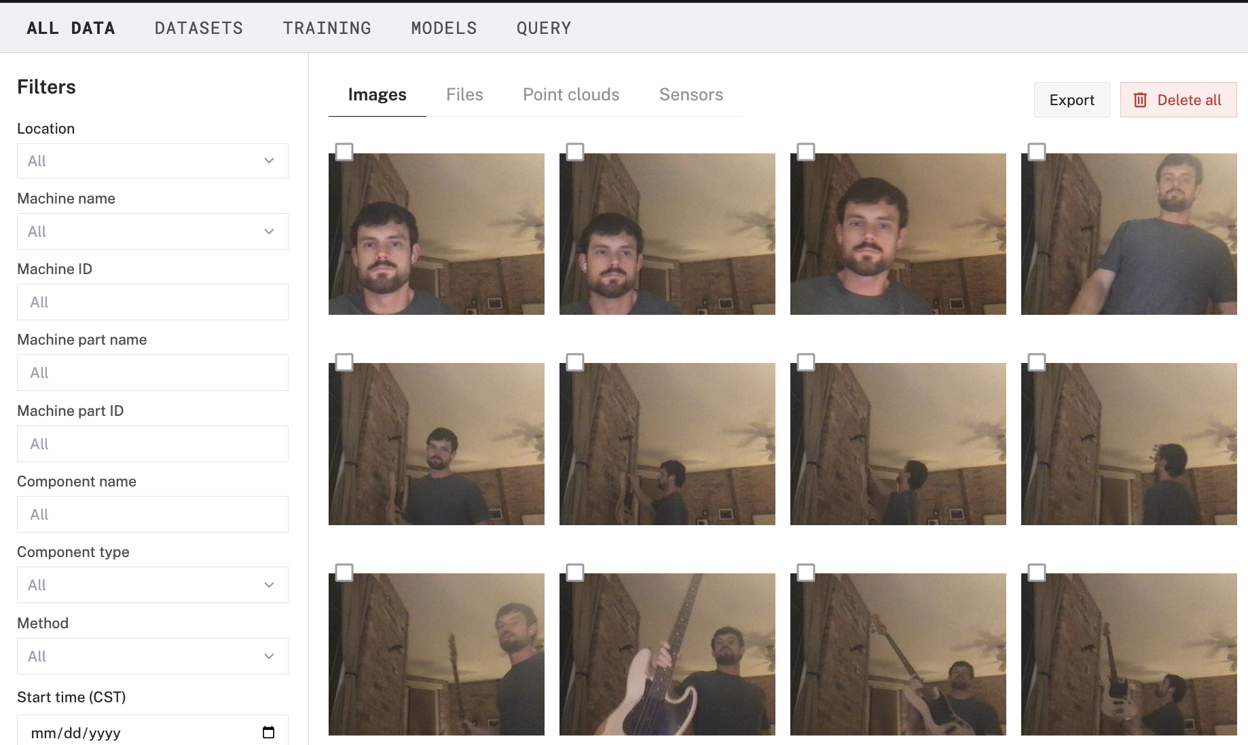
Part 2 – Cloud Storage

Slide 4
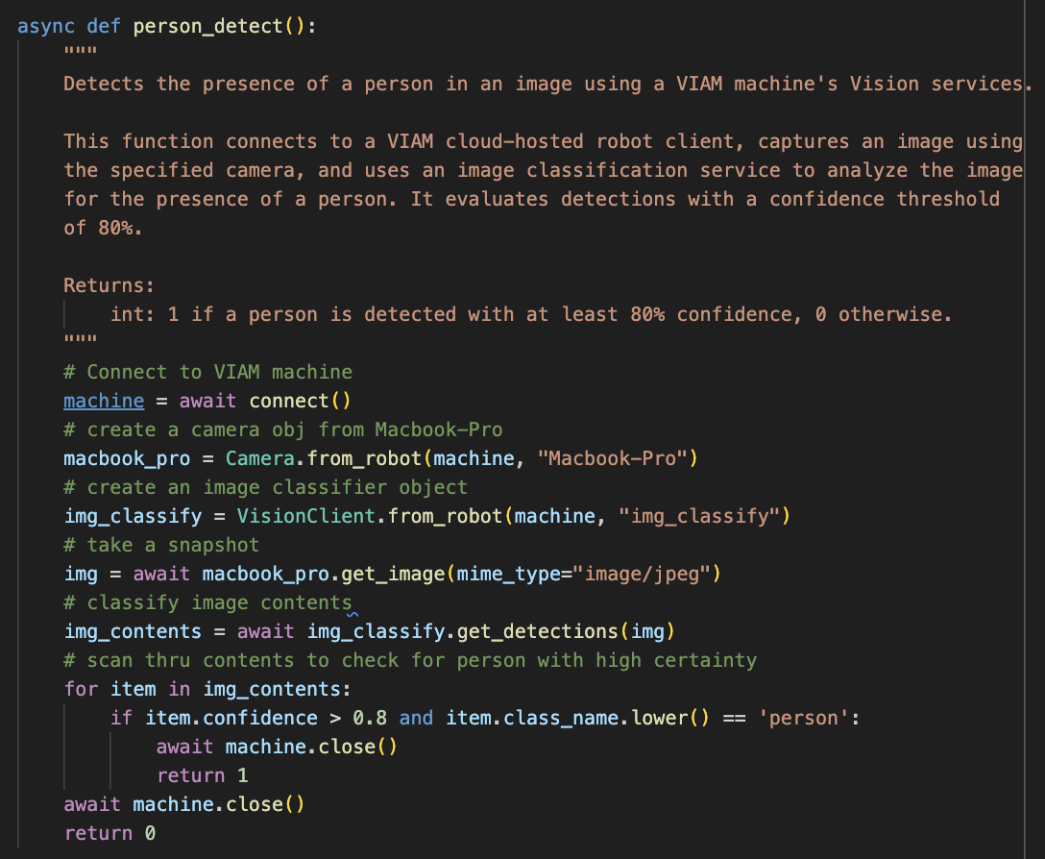
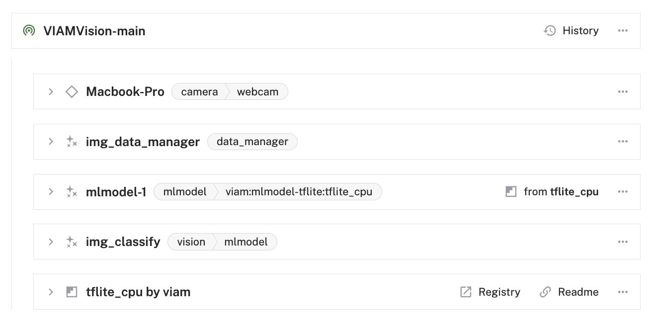
Part 3 – ML Person Detect

Slide 5
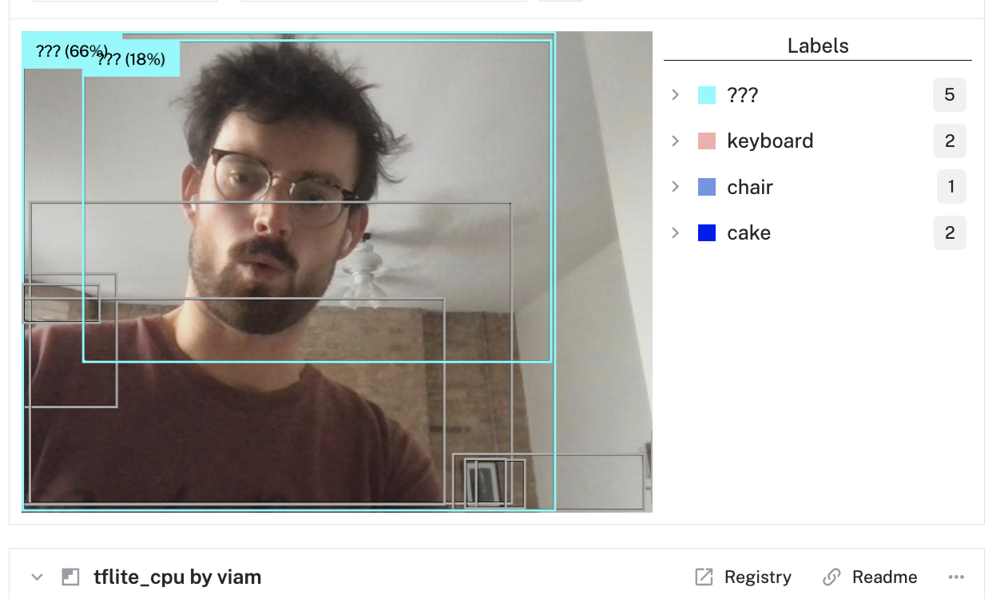
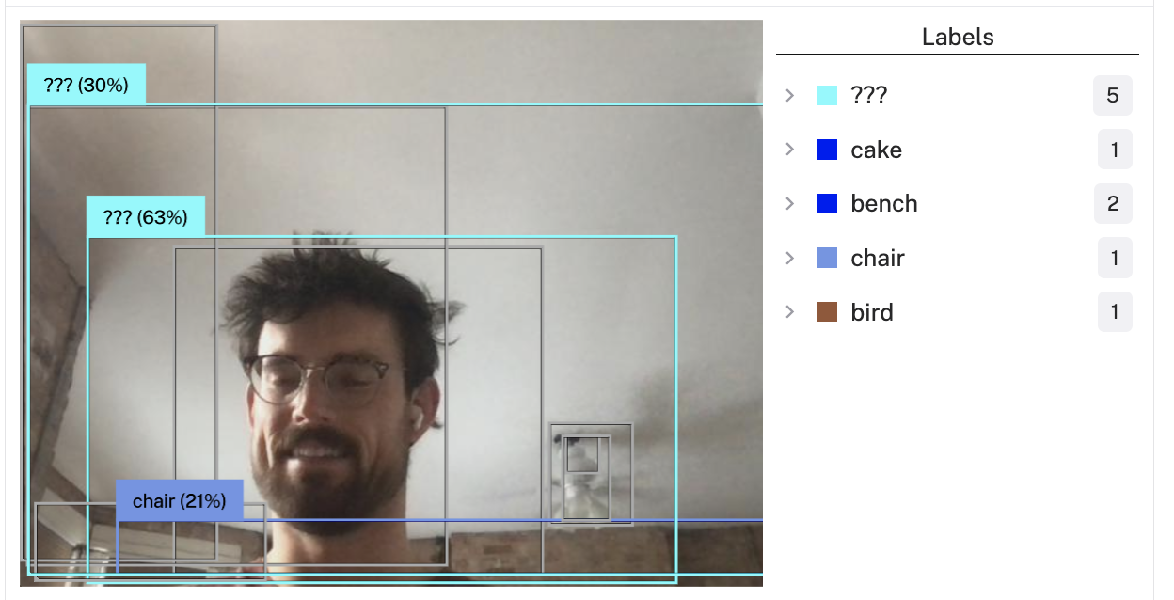
Person detection

Slide 6
Challenges
Information in docs is spread across multiple endpoints
Installation user journey allows installation of software that hasn’t been programmed on user-specific hardware (leads to non-insightful error messages)
ML APIs are are not quite production grade and stack trace errors throw errors that should not be delivered to an end user
Hardware incompatibility (Felix super helpful)

Slide 7
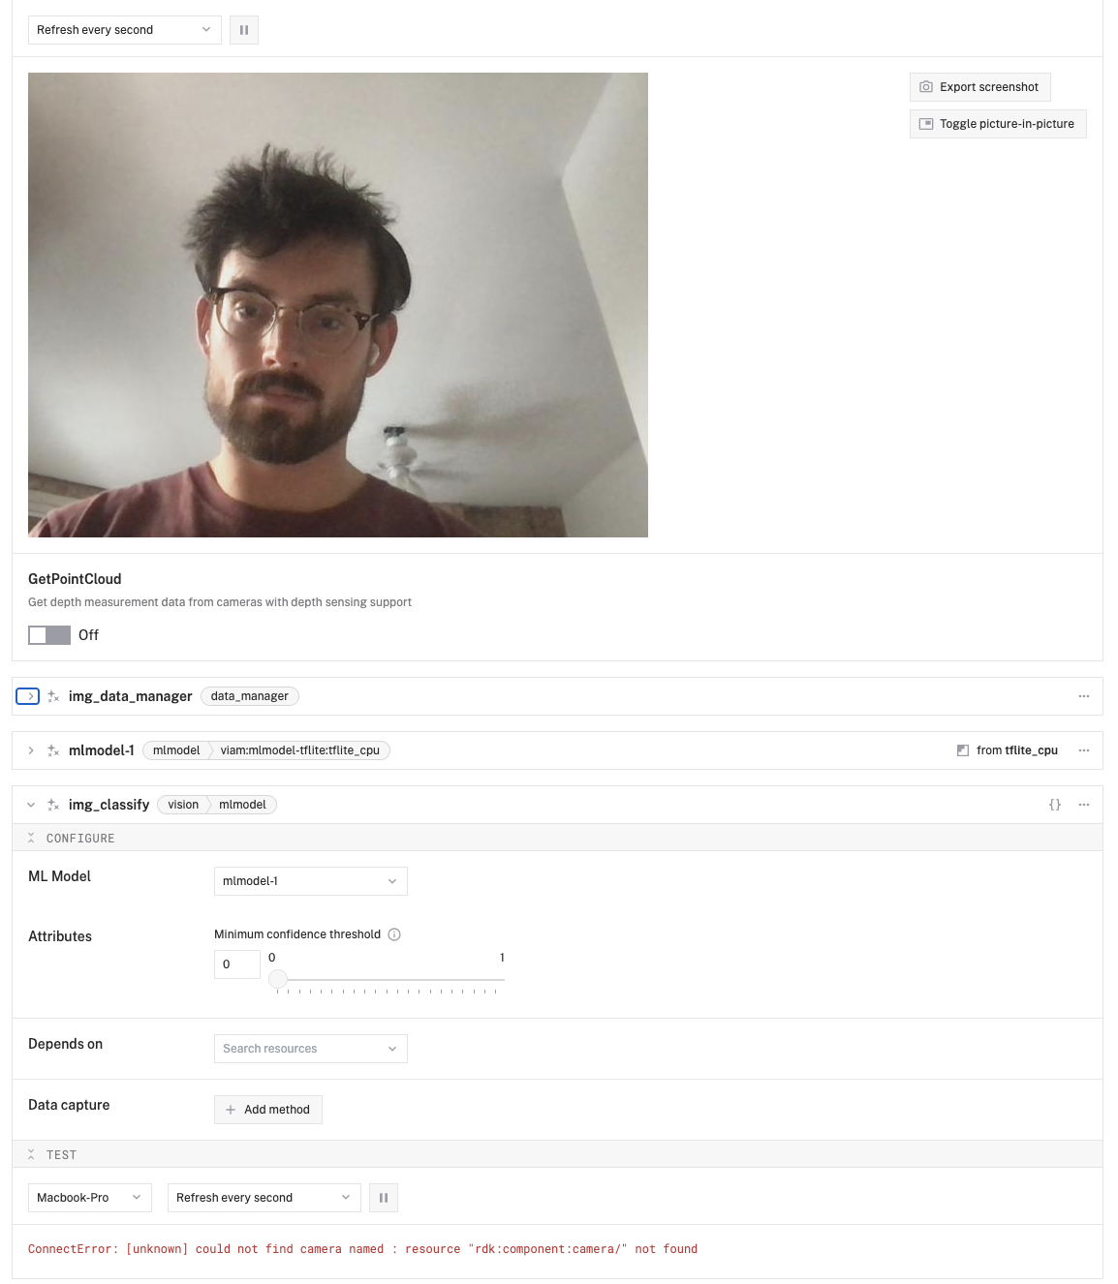
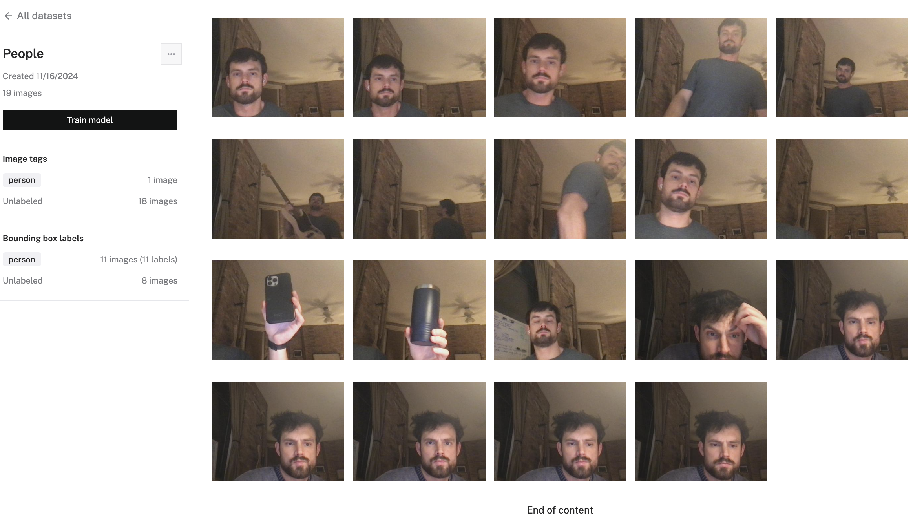
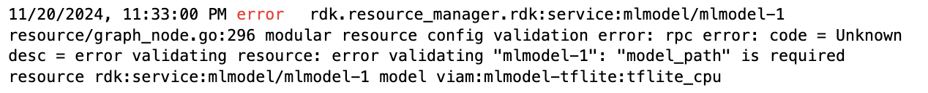
Challenges - bugs

